Slide 1
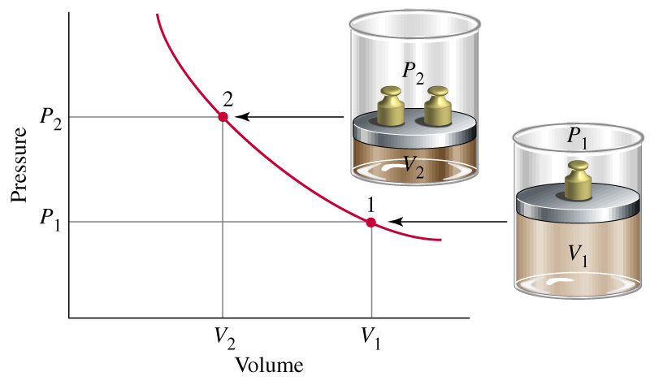
Relationship between gas volume and pressure-Boyle’s law. When the temperature and amount of gas are held constant, gas volume is inversely proportional to the pressure: a doubling of the pressure causes the volume to decrease to one-half its original value.

Slide 2
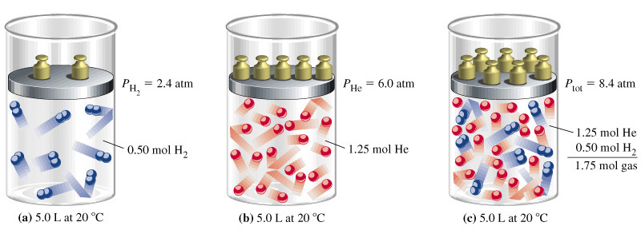
Dalton’s law of partial pressures

Slide 3
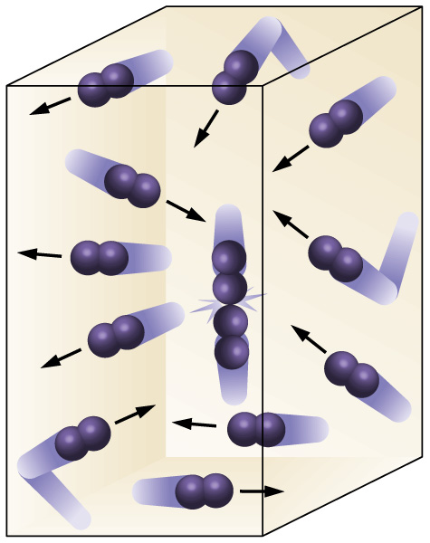

Slide 4
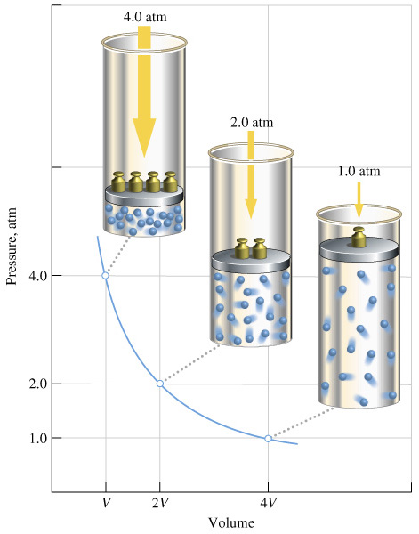

Slide 5
The inversely proportional relationship means that the product PV = a constant. As a result Boyles Law is usually represented mathematically as
where P1 = initial pressure
V1 = initial volume
P2 = final pressure
V2 = final volume

Slide 6
